Slide 1


Interoperability, OGC Web Services and Standards
By Hochschule für Technik Stuttgart [CC BY-SA 3.0 (http://creativecommons.org/licenses/by-sa/3.0)], via Wikimedia Commons
Franz-Josef Behr, Stuttgart University of Applied Sciences
24.10.2018, Chief Directorate: National Geospatial Information in Cape Town, South Africa
The content is licensed under a Creative Commons-Lizenz CC BY-NC-SA.

Slide 2
Outline
Interoperability
Standardization
OGC and ist standards – a short overview
WFS as an example for interoperability
Tools
A few use cases
Summary and some recommendation

Slide 3
Interoperability: Definition
The ability to collaborate and to exchange information seeminglessly and without barriers.
Often restricted to technical aspects.
But: Interoperability should be extended.
Notes:
Technical Interoperabilty
Personal Interoperabilty
Semantical Interoperabilty
Institutional Interoperabilty
Political Interoperabilty

Slide 4
Interoperability: OGC‘s Definition
„…software components operating reciprocally (working with each other) to overcome
tedious batch conversion tasks,
import/export obstacles, and
distributed resource access barriers
imposed by
heterogeneous processing environments and
heterogeneous data.
McKee and Buehler, 1998 ; Sondheim, Gardels and Buehler 1999

Slide 5
Interoperability: IEEE‘s Definition
„Ability of two or more systems or components to exchange information and to use the information that has been exchanged.”
(IEEE 1990)

Slide 6
Interoperability: ISO‘s Definition
"The capability to communicate, execute programs, or transfer data among various functional units in a manner that requires the user to have little or no knowledge of the unique characteristics of those units".
(ISO/IEC 2382-36:2008)

Slide 7
Interoperability: a stack of means and contributions
Technical
Interoperabilty
Standards,
scientific work
Personal
Interoperabilty
Challenges & Activities
Semantical
Interoperabilty
Institutional
Interoperabilty
Common Activities
Political
Interoperabilty
Notes:
Technical Interoperabilty
Personal Interoperabilty
Semantical Interoperabilty
Institutional Interoperabilty
Political Interoperabilty

Slide 8
Technical Interoperability: between IT systems
Technical
Interoperabilty
WMS, WFS, WCS, WPS, Shape, GML, KML, …
HTTP, XML, JavaScript
Internatioal Standards
Personal
Interoperabilty
OGC, W3C, ISO & others
Semantical
Interoperabilty
Awareness,
Capacity building,
Education
Contribution
Institutional
Interoperabilty
Standards evolved in many years, often in consensus driven processes
well established
Political
Interoperabilty
Presentations,
workshops, Testbeds,
Hackathons

Slide 9
Personal Interoperability: between people
Communication skills,
personal relationships,
social networking,
cultural understanding,
foreign languages
Technical
Interoperabilty
Personal
Interoperabilty
Relationships
Semantical
Interoperabilty
Interpersonal Standards
Sharing our data
sharing through web services
student / staff / academic exchange
common research
common projects
common outreach and
publications
evolving over years,
Based on trust
and on (scientific( ethics
Institutional
Interoperabilty
Political
Interoperabilty
Meetings,
Tea breaks,
…

Slide 10
Semantical Interoperability: between knowledge islands
Technical
Interoperabilty
Personal
Interoperabilty
Semantical
Interoperabilty
Collaboration between groups and extreme different disciplines
Personal
Interoperabilty
Vocabularies,
Ontologies
Institutional
Interoperabilty
Collaboration between groups and disciplines
Projects.
presentations,
workshops,
sharing time
Transcending the barriers
communication
evolving over years,
based on knowledge
still part of scientific research
Political
Interoperabilty

Slide 11
Semantics
Part of the linguistics (study of language) and semiotics (study of signs)
According to Wikipedia:
  From the ancient Greek: σημαντικός sēmantikós; important),
  the study of meaning
  focuses on the relation between signifiers, like words, phrases, signs, and symbols, and what they stand for, their denotation.

Slide 12
Ontology
In philosphy: "metaphysical science or study of being” [1] study of the nature of being, becoming, existence, or reality, as well as the basic categories of being and their relations
In computer science and information science, an ontology formally represents knowledge as a hierarchy of concepts within a domain, using a shared vocabulary to denote the types, properties and interrelationships of those concepts
"The hierarchical structuring of knowledge about things by subcategorising them according to their essential (or at least relevant and/or cognitive) qualities." [2]
[1] http://www.etymonline.com/index.php?search=ontology&searchmode=none [2014-04-11]
[2] http://foldoc.org/ontology [2014-04-11]

Slide 13
Institutional Interoperability: between organisations
Technical
Interoperabilty
Institutional
Interoperabilty
Personal
Interoperabilty
Personal
Interoperabilty
Semantical
Interoperabilty
Liaisons,
Agreements, common projects
Memorandum of Understand
(MoU),
…
Relationships
dependencies
evolving over years,
based on decision, shaped by communicated convictions
Interpersonal Standards
Political
Interoperabilty
How can we learn to extend
collaboration?
Notes:
Workshops, presentation?
dual education

Slide 14
Political Interoperability: between communities
Our responsibility?
Technical
Interoperabilty
Our impact?
Technical
Interoperabilty
Institutional
Interoperabilty
Personal
Interoperabilty
Personal
Interoperabilty
Political
Interoperabilty
Semantical
Interoperabilty
Institutional
Interoperabilty
political interests, economical interests
Long term process

Slide 15

By naixn - Flickr: May I serve you?, CC BY-SA 2.0, https://commons.wikimedia.org/w/index.php?curid=17739836
https://commons.wikimedia.org/wiki/File:Waiter_in_Jardin_du_Luxembourg.jpg

Slide 16
IT-Architecture
To support
interoperability

Slide 17
Architecture
DNS Server
IP address
IP address / Server Name / Host name
Client
"User Agent"
HTTP Server
Document root
Static
resources
HTTP-Client
HTTP-Client
HTTP-Client
HTTP
HTTP
80
Internet
80
Communication Tier,
Web Tier
PNG, JPG, …
XML / SVG
Presentation Tier
CGI protocol
Application
Server
Server side programs
Dynamic Generation of resources
Local System
(GIS)
App Tier,
Business Logic Tier
SQL
Data collection, preparation, analysis
DBMS
Server
Data Tier
like Geodata

Slide 18
Architecture: Common Standards
DNS Server
Identification
Transfer of
Encoded Information
IP address
URI
RFC 1630
IP address / Server Name / Host name
Client
"User Agent"
Content-Type
RFC 2045
HTTP
RFC 2616
Webserver
Document root
Static
resources
HTTP-Client
HTTP-Client
HTTP-Client
HTTP
HTTP
80
Internet
80
Communication Tier,
Web Tier
PNG, JPG, …
XML / SVG
XML
w3.org/XML/
CGI
RFC 3875
CGI protocol
Presentation Tier
Application
Server
Server side programs
Dynamic Generation of resources
Local GIS
Encoding
SQL
ISO/IEC 9075
Application Tier,
Business Logic Tier
SQL
Data preparation, analysis
DBMS
Server
Data Tier
Data update and
retrieval

Slide 19
Architecture: OGC Standards
DNS Server
Identification
Transfer of
Encoded Information
IP address
URI
RFC 1630
OGC
IP address / Server Name / Host name
Client
"User Agent"
Content-Type
RFC 2045
HTTP
RFC 2616
Webserver
Document root
Static
resources
HTTP-Client
HTTP-Client
HTTP-Client
HTTP
HTTP
80
Internet
80
Communication Tier,
Web Tier
PNG, JPG, …
XML / SVG
OGC
XML
w3.org/XML/
CGI
RFC 3875
CGI protocol
Presentation Tier
Application
Server
OGC
Server side programs
Dynamic Generation of resources
Local GIS
Encoding
SQL
ISO/IEC 9075
Application Tier,
Business Logic Tier
SQL
Data preparation, analysis
DBMS
Server
OGC
Data Tier
Data update and
retrieval

Slide 20
A (Geo-) Web Service Example: Contour Lines
DNS Server
2
IP address
URI
RFC 1630
Transfer
IP address / Server Name / Host name
Client
"User Agent"
Content-Type
RFC 2045
HTTP
RFC 2616
Webserver
Document root
Static
resources
HTTP-Client
HTTP-Client
HTTP-Client
HTTP
HTTP
80
Internet
80
Communication Tier,
Web Tier
PNG, JPG, …
XML / SVG
CGI
RFC 3875
CGI protocol
Presentation Tier
Application
Server
Storage
Persistance
Server side programs
Dynamic Generation of resources
3
Local GIS
Application Tier,
Business Logic Tier
SQL
ISO/IEC 9075
Data Collection /
Preparation
1
SQL
Data preparation, analysis
DBMS
Server
Geometries (contour lines)
(Simple Features)
Data Tier

Slide 21
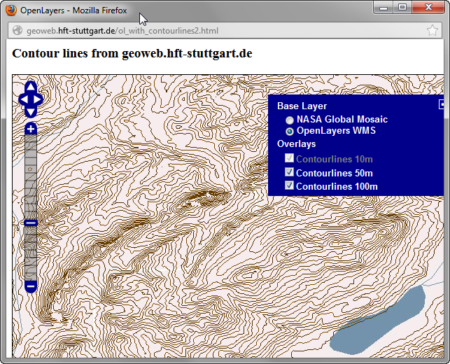
A (Geo-) Web Service Example: Contour Lines
DNS Server
http://geoweb.hft-stuttgart.de/service=wms&operation=getmap...
4
IP address
URI
RFC 1630
Transfer
IP address / Server Name / Host name
Client
"User Agent"
Content-Type
RFC 2045
HTTP
RFC 2616
Webserver
Document root
Static
resources
HTTP-Client
HTTP-Client
HTTP-Client
HTTP
HTTP
80
Image/png
Internet
80
Communication Tier,
Web Tier
Web Map Service
PNG, JPG, …
XML / SVG
3
CGI
RFC 3875
CGI protocol
Data rendering
Presentation Tier
Application
Server
Server side programs
Dynamic Generation of resources
2
Local GIS
Data retrieval
SQL
ISO/IEC 9075
Application Tier,
Business Logic Tier
1
SQL
Data preparation, analysis
Request
DBMS
Server
Geometries (contour lines)
(Simple Features)
4
Data Tier
Presentation

Slide 22
A (Geo-) Web Service Example: Contour Lines
DNS Server
http://geoweb.hft-stuttgart.de/ol_with_contourlines2.html
IP address
URI
RFC 1630
IP address / Server Name / Host name
Client
"User Agent"
Content-Type
RFC 2045
HTTP
RFC 2616
Webserver
Document root
Static
resources
HTTP-Client
HTTP-Client
HTTP-Client
HTTP
HTTP
80
text/xml
Web Feature Service
Internet
80
Communication Tier,
Web Tier
PNG, JPG, …
XML / SVG
<contour height="550.0">
<gml:lineStringProperty>
<gml:LineString
srsName="http://www.opengis.net/gml/srs/epsg.xml#4326">
<gml:coordinates>
9510.0,4333.0 9536.4,4320.1 9555.5,4310.7
</gml:coordinates>
</gml:LineString>
</gml:lineStringProperty >
</contour>
CGI
RFC 3875
CGI protocol
Presentation Tier
Application
Server
Server side programs
Dynamic Generation of resources
Local GIS
Application Tier,
Business Logic Tier
SQL
ISO/IEC 9075
Data Presentation
SQL
Data preparation, analysis
DBMS
Server
Geometries (contour lines)
(Simple Features)
Data Tier

Slide 23
OGC Services and
Encodings

Slide 24
Founded 1994 (from Open GRASS Foundation)
> 525 member organisations
2011: "Number of European members exceeded number of North American members for the first time."
~ 100 innovation initiatives
~ 48 Open Standards
~ 230 OGC certified products
Thousands of implementations
http://www.opengeospatial.org/ogc/historylong

Slide 25
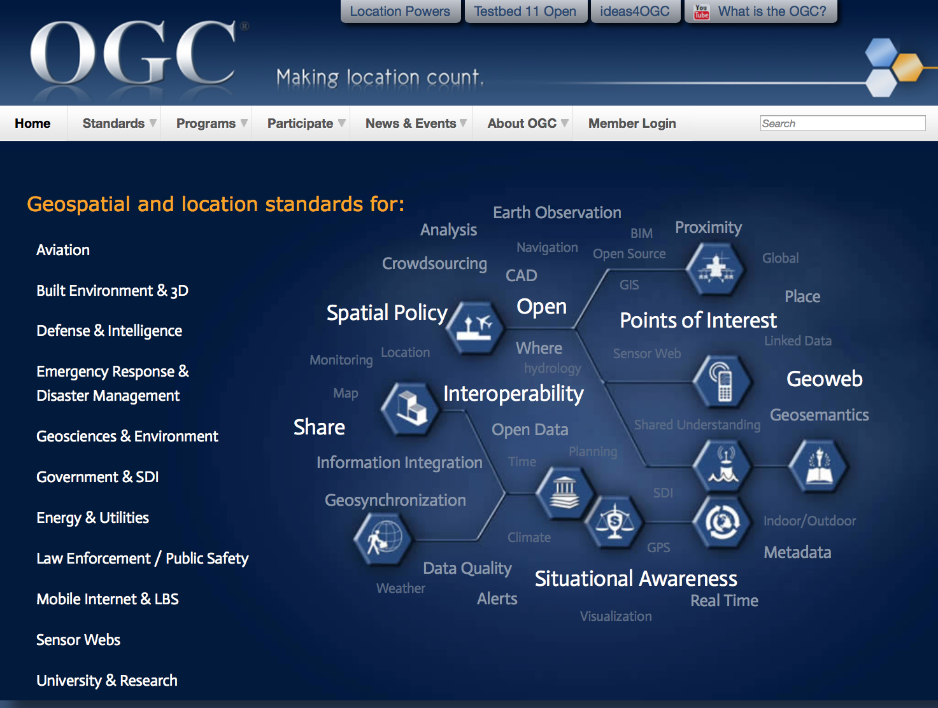
Gebiete
Aviation
Built Environment & 3D
Business Intelligence
Defence & Intelligence (D&I)
Emergency Response & Disaster Management
Energy & Utilities
Geosciences & Environment
Government & Spatial Data Infrastructure
Mobile Internet & Location Services
Sensor Webs
University and Research
Vgl. http://www.opengeospatial.org/domain
Business Intelligence

Slide 26
OGC-Standards (services and encodings)
3dP
ARML2.0
Cat: ebRIM App Profile: Earth Observation Products
Catalogue Service
CDB
CityGML
Coordinate Transformation
Filter Encoding
GML in JPEG 2000
GeoAPI
GeoPackage
GeoSciML
GeoSPARQL
Geography Markup Language
GeoRSS
Geospatial eXtensible Access Control Markup Language (GeoXACML)
Geospatial User Feedback (GUF)
GroundwaterML
i3s
IndoorGML
InfraGML
KML
LandInfra
Location Services (OpenLS)
Moving Features
NetCDF
Observations and Measurements
Open GeoSMS
OpenMI
OpenSearch Geo
Ordering Services Framework for Earth
Observation Products
OWS Context
PubSub
PUCK
SWE Common Data Model
SWE Service Model
Sensor Model Language
Sensor Observation Service
Sensor Planning Service
SensorThings
Simple Features
Simple Features CORBA
Simple Features OLE/COM
Simple Features SQL
Styled Layer Descriptor
Symbology Encoding
Table Joining Service
TimeseriesML (tsml)
WaterML
Web Coverage Processing Service
Web Coverage Service
Web Feature Service
Web Map Context
Web Map Service
Web Map Tile Service
Web Processing Service
Web Service Common
WKT CRS
http://www.opengeospatial.org/docs/is [2017-10-24]
Notes:
3dP
ARML2.0
Cat: ebRIM App Profile: Earth Observation Products
Catalogue Service
CDB
CityGML
Coordinate Transformation
Filter Encoding
GML in JPEG 2000
GeoAPI
GeoPackage
GeoSciML
GeoSPARQL
Geography Markup Language
GeoRSS
Geospatial eXtensible Access Control Markup Language (GeoXACML)
Geospatial User Feedback (GUF)
GroundwaterML
i3s
IndoorGML
InfraGML
KML
LandInfra
Location Services (OpenLS)
Moving Features
NetCDF
Observations and Measurements
Open GeoSMS

Slide 27
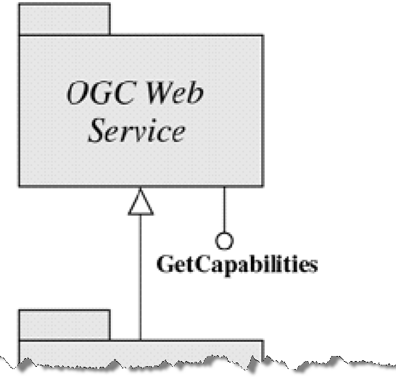
OGC Services
OGC Reference Model:
„OGC Web Services (OWS) are defined using open non-proprietary Internet standards; in particular the World Wide Web (WWW) standards of HTTP, Uniform Resource Locators (URLs), Multipurpose Internet Mail Extensions (MIME) types and the Extensible Markup Language (XML).“
http://www.opengeospatial.org/standards/orm

Slide 28
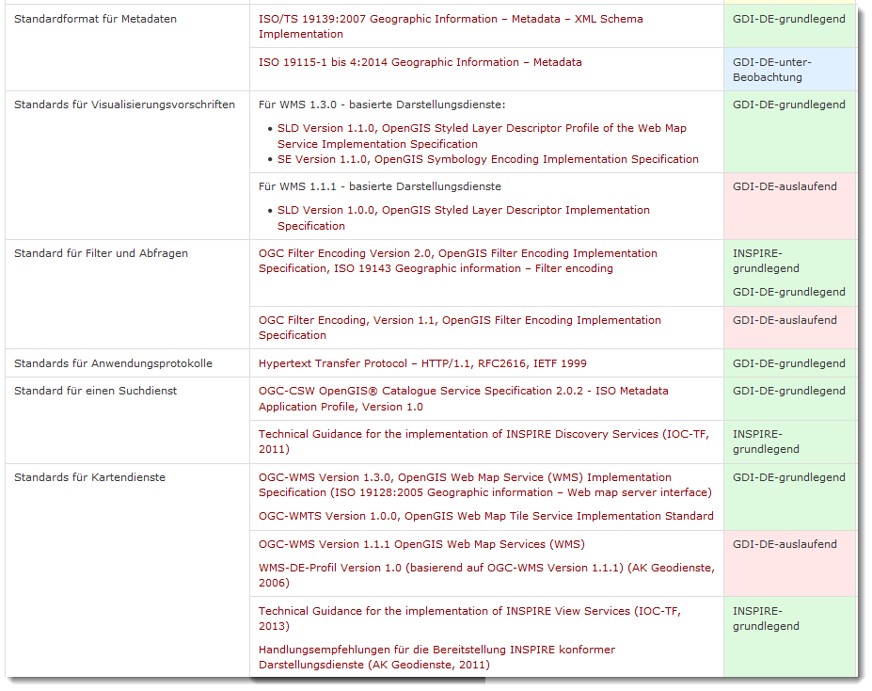
Which are the important standards/services?
From the viewpoint of GDI-DE (German SDI Governmental Body):
essential
under observation
https://wiki.gdi-de.org/display/Arch/Verzeichnis%20GDI-DE%20Standards []2018-03-21
expiring
optional

Slide 29
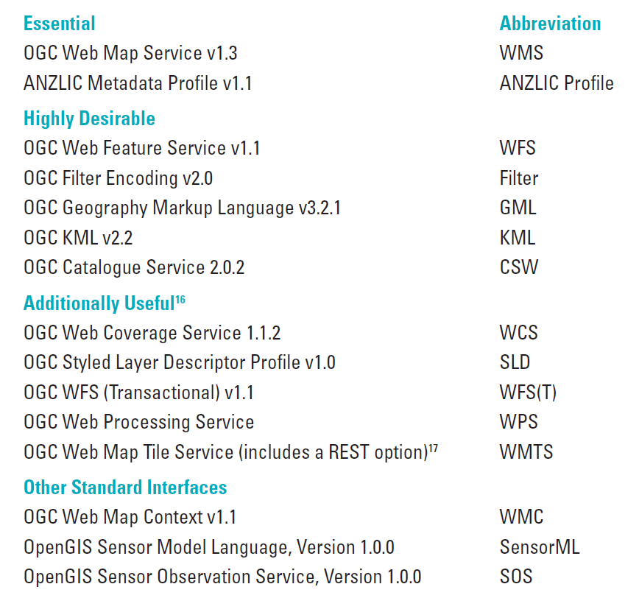
Which are the important standards/services? II
Australia/New Zealand
http://gsdiassociation.org/images/publications/cookbooks/SDI_Cookb2017-10-26ook_New_Zealand_v1-1_17Nov2011.pdf []

Slide 30
Standardization

Slide 31
Standardization Bodies and their Relationship
Class A
liaison
OpenGeoSpatial
Consortium
(OGC)
Internet Engineering
Task Force (IETF)
ISO
OGC: WMS, WFS, GML, WCS, SLD,, Catalog Service, Sensor Web
HTTP, DNS, Addressing
TC 211
TC 287
World Wide
Web Consortium
(W3C)
Class C Liaison:
XML, I18N
JTC-1
W3C: HTTP, PNG, RDF, SOAP/XMLP XML, Xlink, Xpath, Xpointer, XSL/XSLT, XML Schema
ISO: Reference model, Conceptual schema language, Terminology, Profiles, Spatial Schema, Temporal Schema, Schema for moving features, Feature Cataloguing Methodology, Spatial Ref by Coords and Ids, Quality, Metadata, WMS, GML, LBS, Registration of Geo-information Items
Review &
approve
stds.
Provide
expertise &
candidate stds.
Facilitation Bodies
GSDI
ANZLIC
FGDC
INSPIRE
GeoConnections
AGI
AdV
BMI
SASDI
National
Standards
Organizations
DIN, ASI, SNV
Adopter/
Implementer Community
Metadata Profile, Data Content Standards, etc.
Establish definition of and terms of engagement in *SDI
modifiziert nach Doug Nebert (2003): Geospatial Standards
in Action. http://www.fgdc.gov/library/presentations/documents/2003-presentations/GIS_Standards_Rockies1003.ppt
Notes:
CEOS, Committee on Earth Observation Satellites
DGIWG, Digital Geographic Information Working Group
EPSG, European Petroleum Survey Group
FIG, International Federation of Surveyors
GSDI, Global Spatial Data Infrastructure
IAG, International Association of Geodesy
ICA, International Cartographic Association
ICAO, International Civil Aviation Organization
IEEE, Geoscience and Remote Sensing Society
IHB, International Hydrographic Bureau
ISCGM, International Steering Committee for Global Mapping
ISPRS, International Society for Photogrammetry and Remote Sensing
JRC, Joint Research Centre, European Commission
OGC, Open GIS Consortium
PCGIAP, Permanent Committee on GIS Infrastructure for Asia and
the Pacific
UNECE Economic Commission for Europe, Statistical Division
UNFAO Food and Agriculture Organization
UNGEGN, United Nations Group of Experts on Geographic Names
UNGIWG, United Nations Geographic Information Working Group
WMO, World Meteorological Organization
PCIDEA, Permanent Committee on Spatial Data Infrastructure for the
Americas
SCAR, Scientific Committee on Antarctic Research
CEN/TC 287, Geographic information
UN Geographic Information Working Group
(UNGIWG)
• UN FAO GeoNetwork
Permanent Committee on GIS Infrastructure for
Asia and the Pacific (PCGIAP)
International Steering Committee for Global
Mapping (ISCGM)
W3C uses the term "liaison" to refer to coordination of activities with a variety of organizations, through a number of mechanisms ranging from very informal (e.g., an individual from another organization participates in a W3C Working Group, or just follows its work) to mutual membership, to even more formal agreements.

Slide 32

Standardization: Invitation for Engagement
European Commission policy officer in the Directorate-General for the environment
https://www.facebook.com/arnulf.christl/posts/1321347667893631

Slide 33
Web Feature Service (WFS)
GDI-DE-fundamental
INSPIRE-fundamental

Slide 34
Web Feature Service
Offers search for geospatial feature nach raumbezogenen Informationen aus beliebigen objekt-orientierten Vektordatenbeständen
Supports any kind of attributes
Provides feature geometry encoded in GML (amongst others)
„WMS = images“ in contrary to „WFS = Data“
Vretanos, P. A. (ed.) (2010a): OpenGIS Web Feature Service 2.0 Interface Standard (also ISO 19142). http://portal.opengeospatial.org/files/?artifact_id=39967 [2012-12-04]

Slide 35
WFS: Varianten
WFS Categories | Operations
Simple WFS | GetCapabilities, DescribeFeatureType, ListStoredQueries, DescribeStoredQueries und GetFeature (nur über StoredQuery)
Basic WFS | wie Simple WFS, zusätzlich GetPropertyValue und GetFeature mit Query action
Transactional WFS | wie Basic WFS, zusätzlich Transaction
Locking WFS | wie Transactional WFS, zusätzlich eine der Operationen GetFeatureWithLock oder LockFeature
Relevant standards:
ISO 19142 - Web Feature Service 2.0
ISO 19143 - Filter Encoding Standard 2.0
ISO 19136 - Geography Markup Language 3.2

Slide 36
WFS: Operationen
GetCapabilities: liefert Metadaten zu den Operationen, die ein bestimmter Server anbietet, und auf Datenebene Metadaten zu den vom Server angebotenen Feature-Typen.
DescribeFeatureType: generiert ein XML-Schema-Dokument, das vom Dienst angebotene Feature-Typen als XSD-Dokument beschreibt.
GetPropertyValue: Werte ausgewählter Feature-Eigenschaften können auf der Basis von vom Client festgelegten Abfrageeinschränkungen abgerufen werden.
GetFeature: erlaubt den Abruf von Feature-Instanzen auf der Basis von vom Client festgelegten Abfrageeinschränkungen. Wie auch GetPropertyValue können mit Hilfe eines Filterausdrucks kodierte Abfrageprädikate räumliche, zeitliche und thematische Einschränkungen umfassen.
GetFeatureWithLock: verhält sich genauso wie die Operation „GetFeature“, jedoch werden alle von der Operation identifizierten Feature-Instanzen im Voraus gegen anstehende „Transaction“-Operationen gesperrt.

Slide 37
GetCapabilities-Request
The WCS GetCapabilities operation is a request to a WCS server for a list of operations and services (“capabilities”) offered. Basically the following informations are provided:
  Service Identification: General information about the Web Coverage Service and WCS profiles it supports
  Service Provider: Name and contact details about the service and data provider
  OperationsMetadata: Supported WCS operations of the service
  ServiceMetadata: Supported format encodings and interpolations methods of the service
  Contents: Available data sets of the service

Slide 38
Basic approach
Retrieve Service Metadata
… To setup your client system
Retrieve more detailed information (i.e. metadata) about specific service options or feature classes (i.e. data model)
… To setup your client system
Retrieve the data
Consume the data
… in your client system

Slide 39
1. Retrieve Service Metadata
The GetCapabilities operation delivers a service metadata document describing a WFS service provided by a server.
The request
http://geoserv.weichand.de:8080/geoserver/wfs?service=WFS&version=1.1.0&request=GetCapabilities

Slide 40
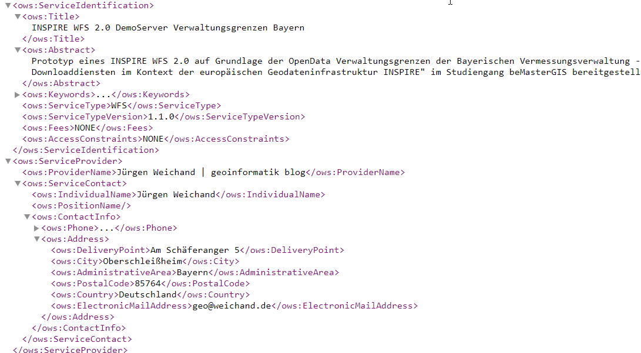
1. Retrieve Service Metadata
The response

Slide 41
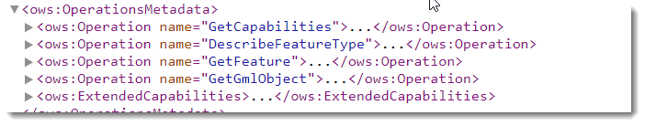
http://geoserv.weichand.de:8080/geoserver/wfs?service=WFS&version=1.1.0&request=GetCapabilities

Slide 42
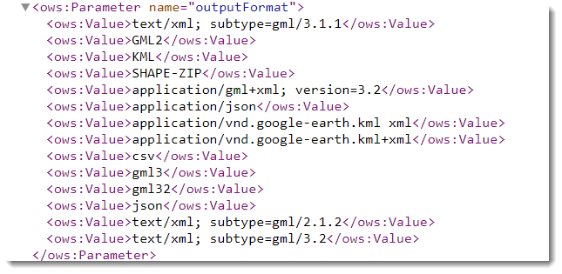
http://geoserv.weichand.de:8080/geoserver/wfs?service=WFS&version=1.1.0&request=GetCapabilities

Slide 43
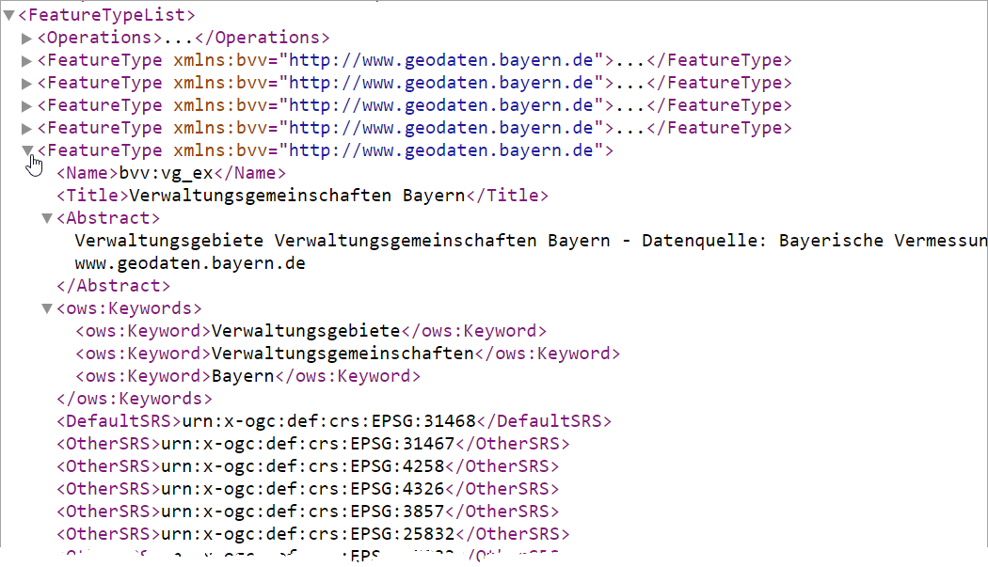
Feature Types: List of class names

Slide 44
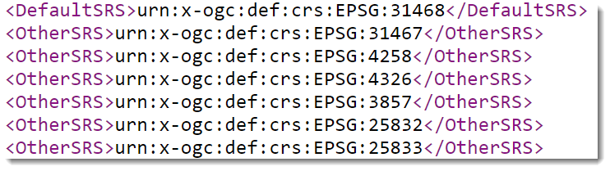
Spatial Reference Systems

Slide 45
Link to Metadata

Slide 46
2. Retrieve detailed information
The DescribeFeatureType operation returns a description of the structure, i. e. a schema description of a feature type offered by a WFS instance.
The request
http://geoserv.weichand.de:8080/geoserver/wfs?service=WFS&version=1.1.0&request=DescribeFeatureType&typeName=bvv:gmd_ex

Slide 47
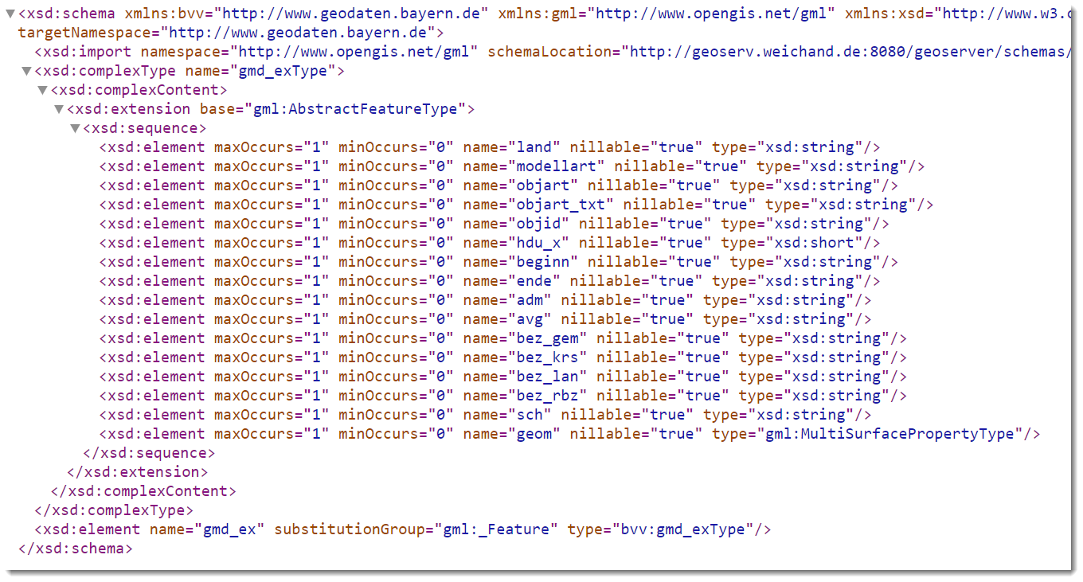
2. Retrieve detailed information - Response

Slide 48
3. Retrieve data: The request
The GetFeature operation allows you to retrieve features from a WFS Server, so-called feature collections
The request
http://geoserv.weichand.de:8080/geoserver/wfs?service=WFS&version=2.0.0&request=GetFeature&typeNames=bvv:gmd_ex&srsName=EPSG:31468&bbox=4450407.80325,5324432.56981,4481624.47895,5346224.56688,EPSG:31468&OutputFormat=GML3

Slide 49
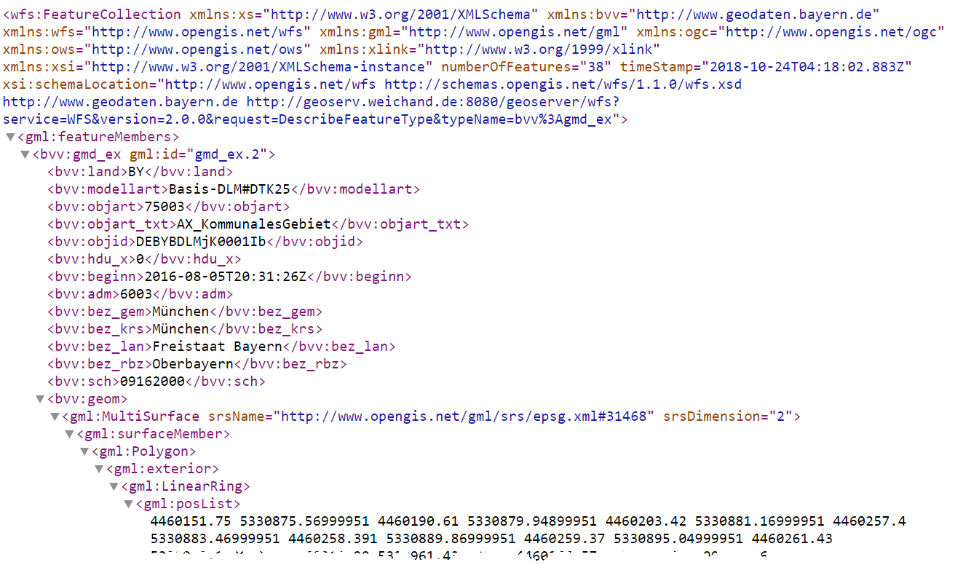
3. Retrieve data: The response

Slide 50
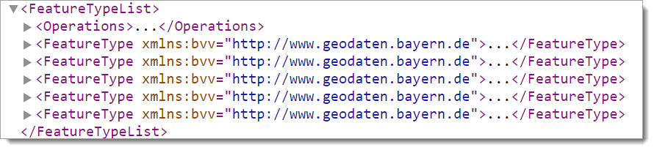
3. Retrieve data: The request
The GetFeature operation allows you to retrieve features from a WFS Server, so-called feature collections
The request
http://geoserv.weichand.de:8080/geoserver/wfs?service=WFS&version=2.0.0&request=GetFeature&typeNames=bvv:gmd_ex&srsName=EPSG:31468&bbox=4450407.80325,5324432.56981,4481624.47895,5346224.56688,EPSG:31468&OutputFormat=GML3

Slide 51
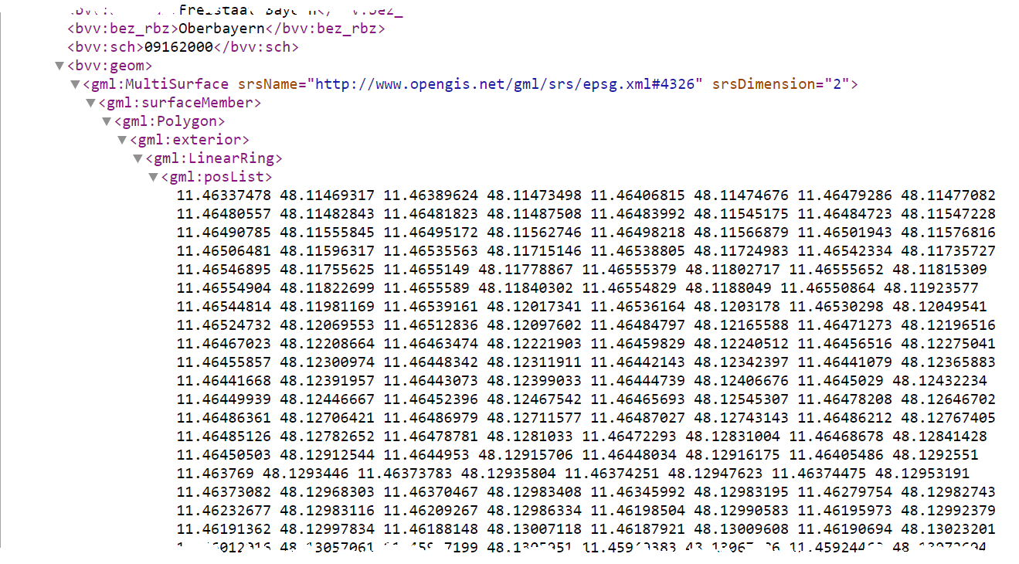

Slide 52
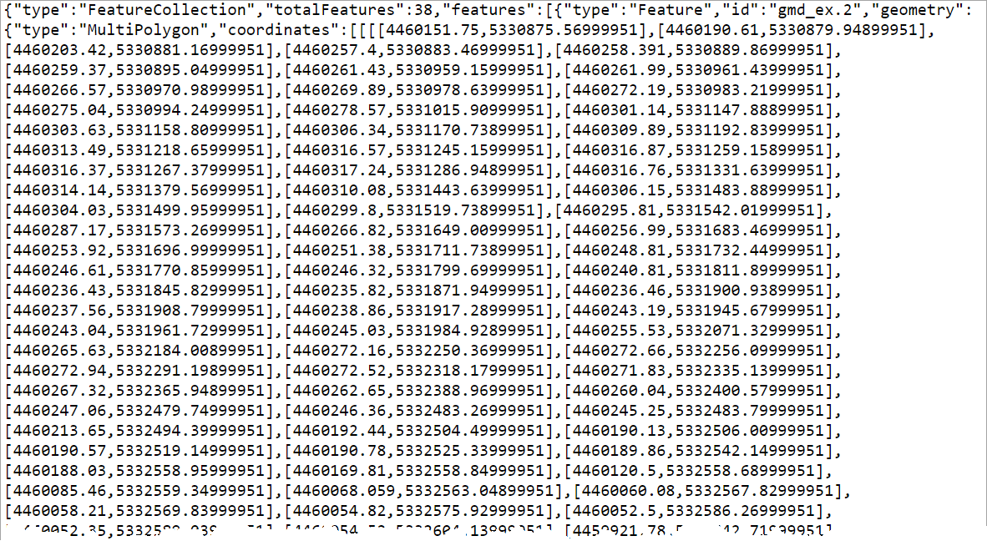

Slide 53
Filter Encoding (FE)
GDI-DE-fundamental
INSPIRE-fundamental
Filters
  are used to select features or other objects.
  similar in functionality to the SQL “WHERE” clause.
  Are specified using conditions.
The Filter Encoding language uses an XML-based syntax.

Slide 54
FE examples
http://geoserv.weichand.de:8080/geoserver/wfs?service=WFS&version=1.0.0&request=GetFeature&typeNames=bvv:gmd_ex&FILTER=<Filter><PropertyIsEqualTo><PropertyName>bez_krs</PropertyName><Literal>Rosenheim</Literal></PropertyIsEqualTo></Filter>
https://www.wfs.nrw.de/geobasis/wfs_nw_alkis_vereinfacht?Service=WFS&REQUEST=GetFeature&VERSION=2.0.0&TYPENAMES=ave:Flurstueck&NAMESPACES=xmlns(ave,http://repository.gdi-de.org/schemas/adv/produkt/alkis-vereinfacht/1.0)&Filter=%3cfes:Filter%20%20xmlns=%22http://www.opengis.net/ogc%22%20xmlns:fes=%22http://www.opengis.net/fes/2.0%22%20xmlns:gml=%22http://www.opengis.net/gml/3.2%22%3e%3cfes:Within%3e%3cfes:ValueReference%3eave:geometrie%3c/fes:ValueReference%3e%3cgml:Polygon%20gml:id=%22P1%22%20srsName=%22urn:ogc:def:crs:EPSG::25832%22%3e%3cgml:exterior%3e%3cgml:LinearRing%3e%3cgml:posList%3e405535%205699461%20405711%205699561%20405916%205699582%20406102%205699454%20406166%205699293%20406234%205699030%20405945%205698913%20405665%205698985%20405506%205699048%20405462%205699253%20405461%205699257%20405535%205699461%3c/gml:posList%3e%3c/gml:LinearRing%3e%3c/gml:exterior%3e%3c/gml:Polygon%3e%3c/fes:Within%3e%3c/fes:Filter%3e

Slide 55
4. Cosuming the data

Slide 56
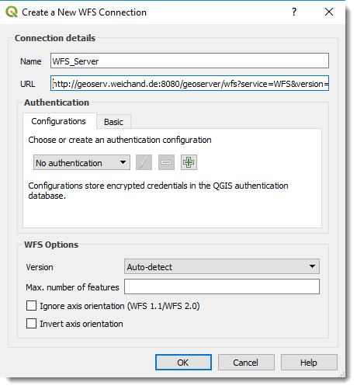
Interoperability Example I (QGIS)

Slide 57
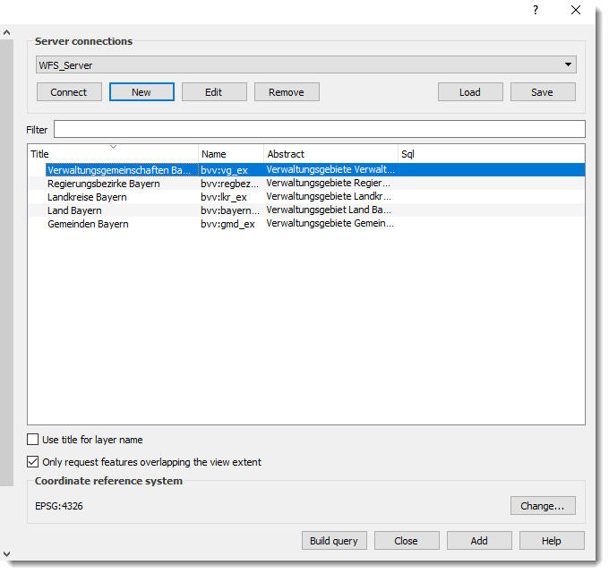

Slide 58
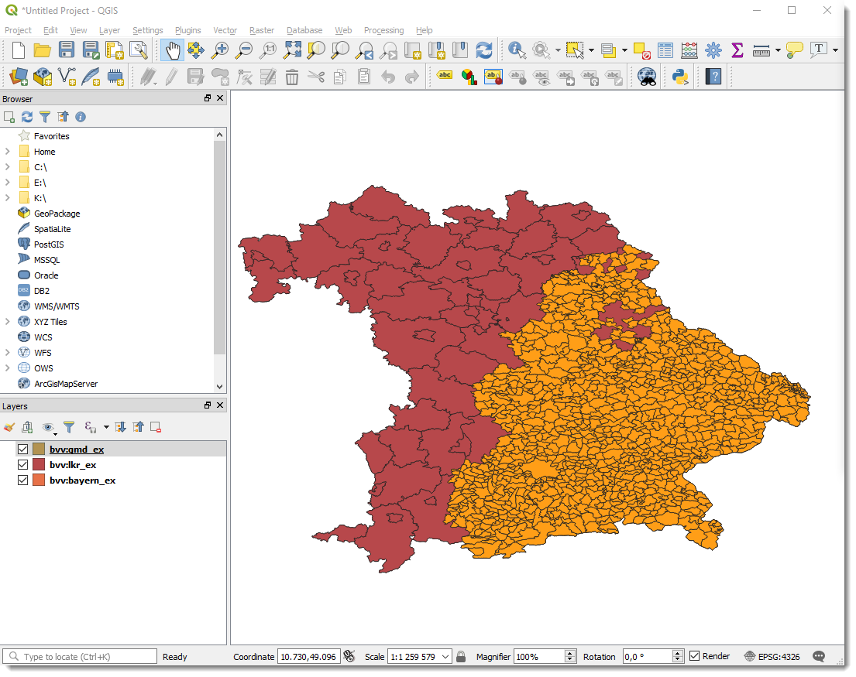

Slide 59
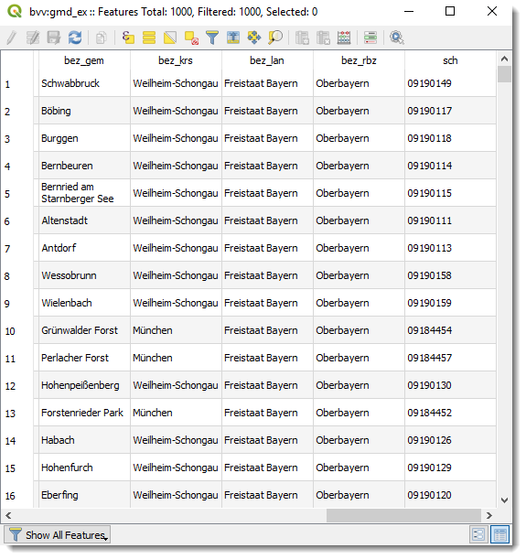

Slide 60
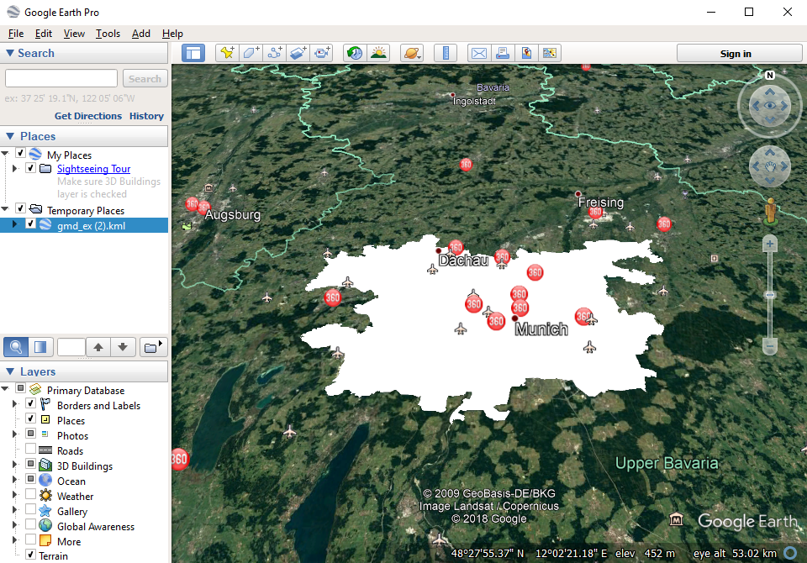
Interoperability Example I (Google Earth)

Slide 61
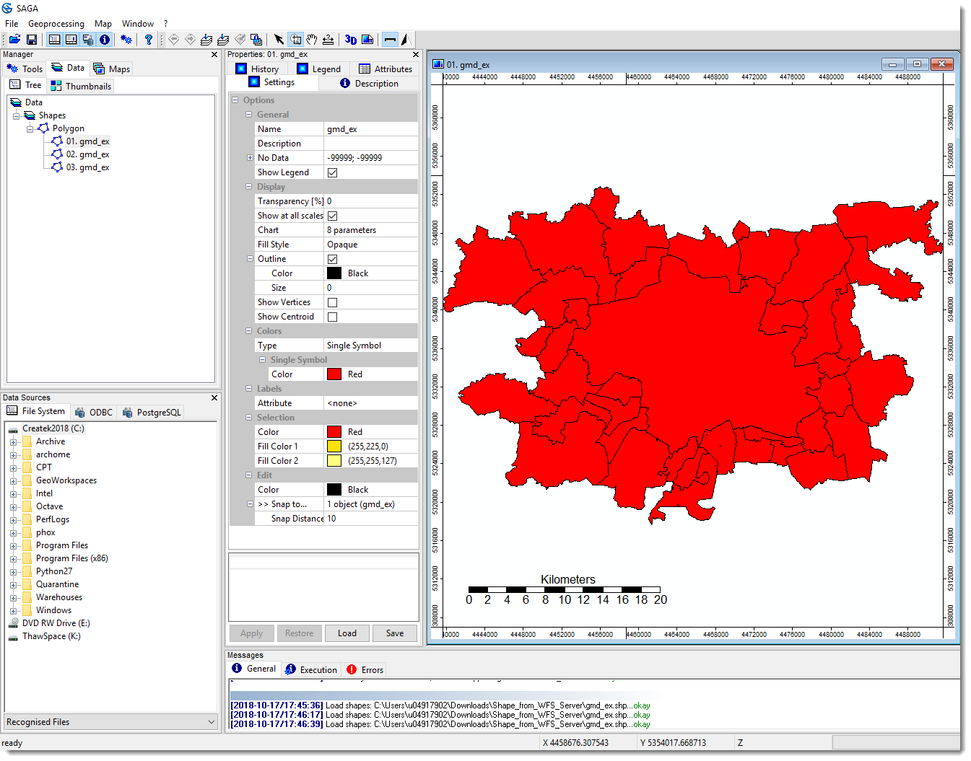
Interoperability Example III (SAGA GIS)

Slide 62
Tools

Slide 63
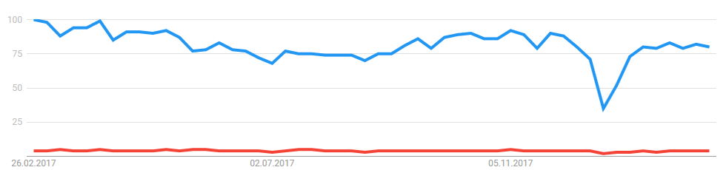
Related Products and Tools: Application Servers
In Geo-IT: Application Servers often follow the standards given by Open Geospatial Consortium (OGC)
  Web Map Service
  Web Feature Service
  Web Coverage Service
  And many more
Geospatial application servers
Closed Source Solutions
Open Source Solutions
https://trends.google.com/trends/explore?q=ArcGIS,GeoServer

Slide 64
Application Servers: Mapping Servers - Open Source
GeoServer
  „an open source software server written in Java that allows users to share and edit geospatial data. Designed for interoperability, it publishes data from any major spatial data source using open standards.“ (http://geoserver.org/display/GEOS/Welcome)
MapServer (formerly called UMN MapServer, http://www.osgeo.org/mapserver)
  Written in C, with PHP wrapper
  WMS, WFS, Strong support of Shape files
  Somehow old-fashioned, configuration by text file („map file“)
Deegree Server
  „deegree is a comprehensive geospatial software package with implementations of OGC Web Services like WMS and WFS, a geoportal, a desktop application, security mechanisms, and various tools for geospatial data processing and management. It is open source (LGPL), Java, standards-compliant (OGC, ISO) and an OSGeo project.“ (http://www.deegree.org/)
  Needs Java, and some time for configuration
MapGuide Open Source
  „enables users to develop and deploy web mapping applications and geospatial web services.“ (http://www.osgeo.org/mapguide)

Slide 65
Application Servers: Mapping Servers – Closed Source
Commercial Products
  ArcGIS Server®
  GeoMedia WebMap Server®
  MapInfo MapXtreme®

Slide 66
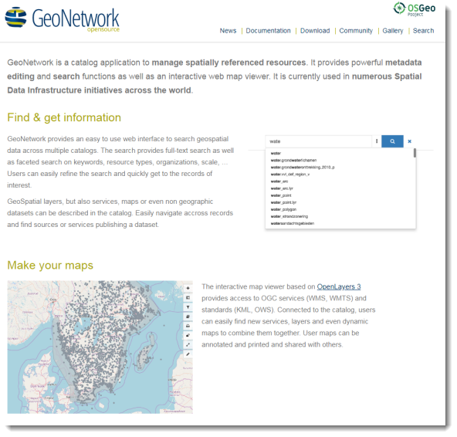
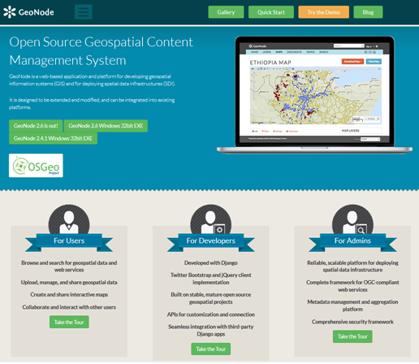
Application Servers: Portal Servers
Geonetwork OpenSource: a widely used catalog application to manage spatially referenced resources
Geonode: for developing geospatial information systems (GIS) and for deploying spatial data infrastructures (SDI).
https://geonetwork-opensource.org/
https://geonode.org/

Slide 67
Related Products and Tools: (O)RDBMS
(O)(R)DBMS: (Object) (Relational) Database Management System
  commercial products
    Oracle,
    SQLServer (Microsoft),
    Informix, DB2 (IBM),
    …
  free
    PostGreSQL (PostGIS), fully conformant to OGC‘s Simple Feature Specification – highly recommended
    MySQL
    SpatialLite

Slide 68
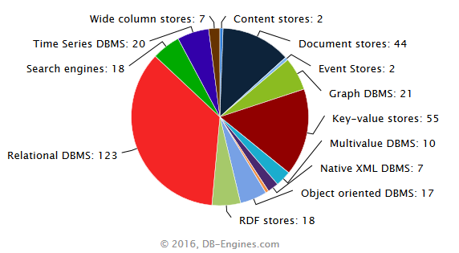
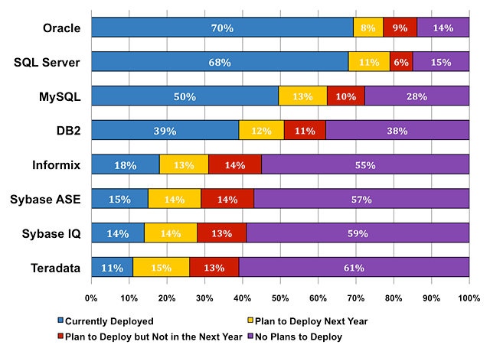
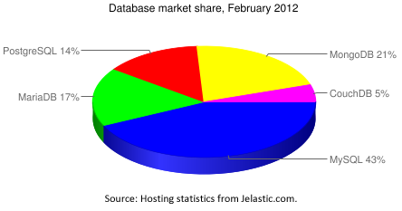
Market share
2008 (Closed Source)
2012 (FOSS)
http://blog.jelastic.com/2012/02/23/open-source-database-market-share-within-jelastic-february-2012/
http://www.mysql.com/why-mysql/marketshare/ [2008, no more available]

Slide 69
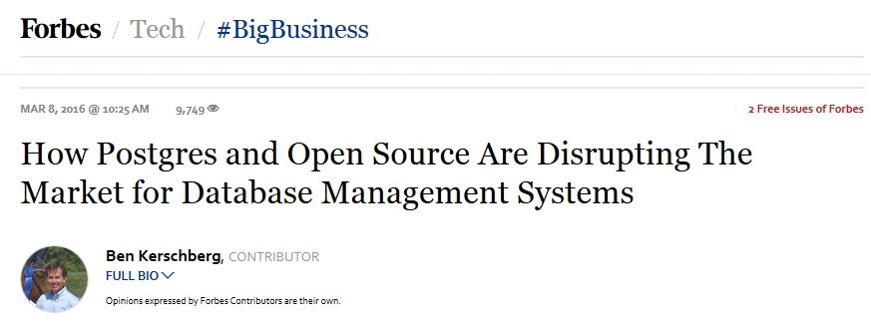
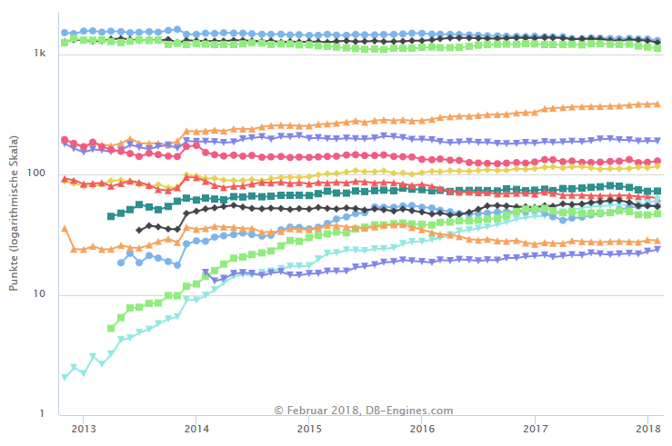
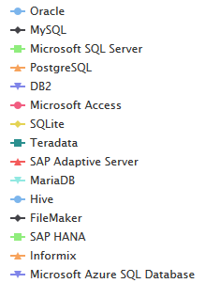
Trend of Relational DBMS Popularity
https://www.forbes.com/sites/benkerschberg/2016/03/08/how-postgres-and-open-source-are-disrupting-the-market-for-database-management-systems/#141b42e820a3
http://db-engines.com/en/ranking_trend/relational+dbms [2018-02-26]

Slide 70
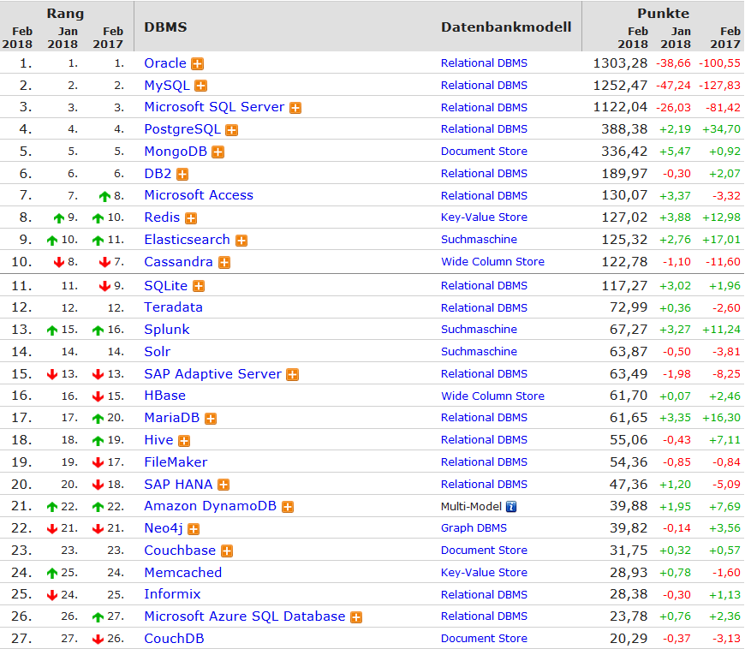
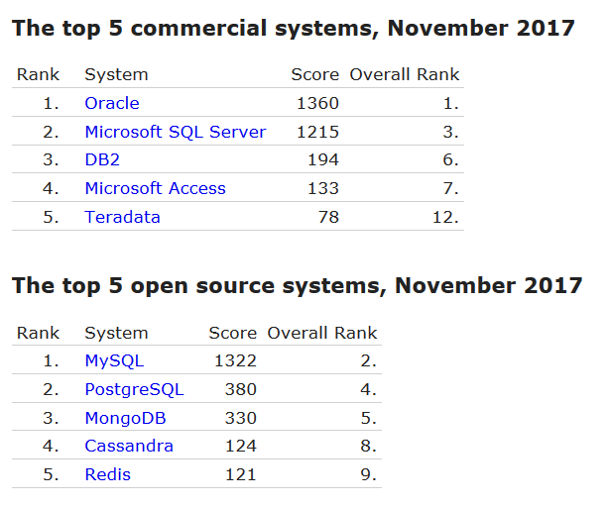
https://db-engines.com/de/ranking [2018-01-26]
http://db-engines.com/en/ranking_categories; http://db-engines.com/en/ranking_osvsc [2017-11-06]

Slide 71
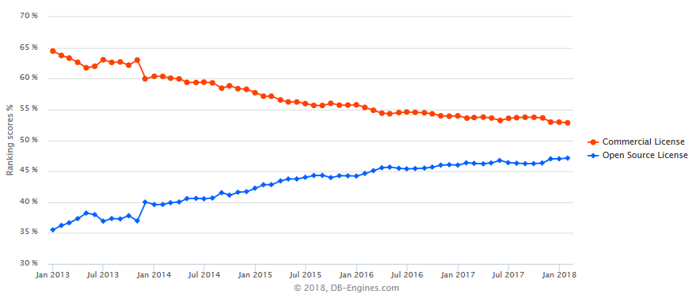
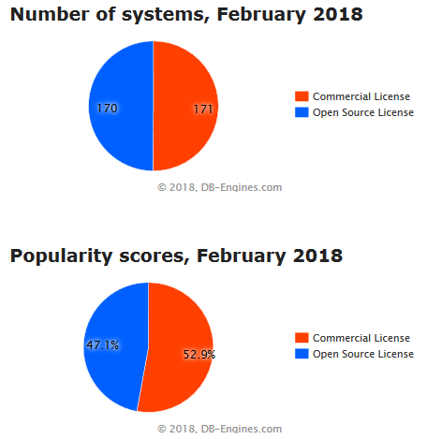
Popularity
Closed Source
Open Source
http://db-engines.com/en/ranking_osvsc [2018-02-26]

Slide 72
Use Cases

Slide 73

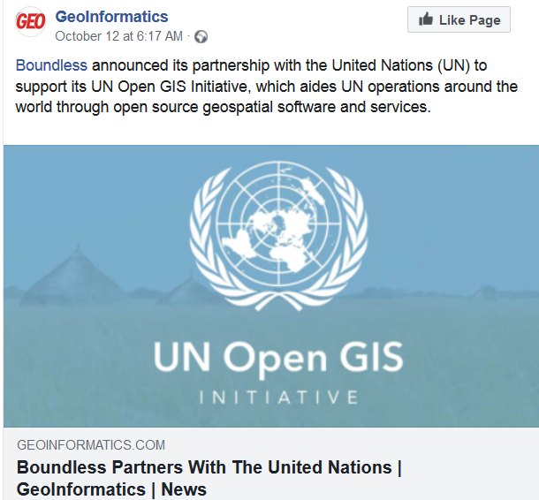
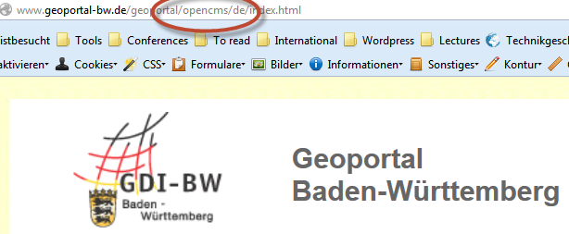
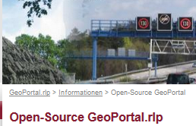
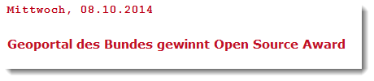
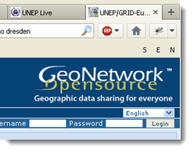
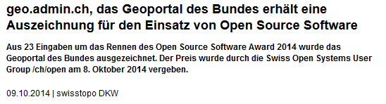


Slide 74
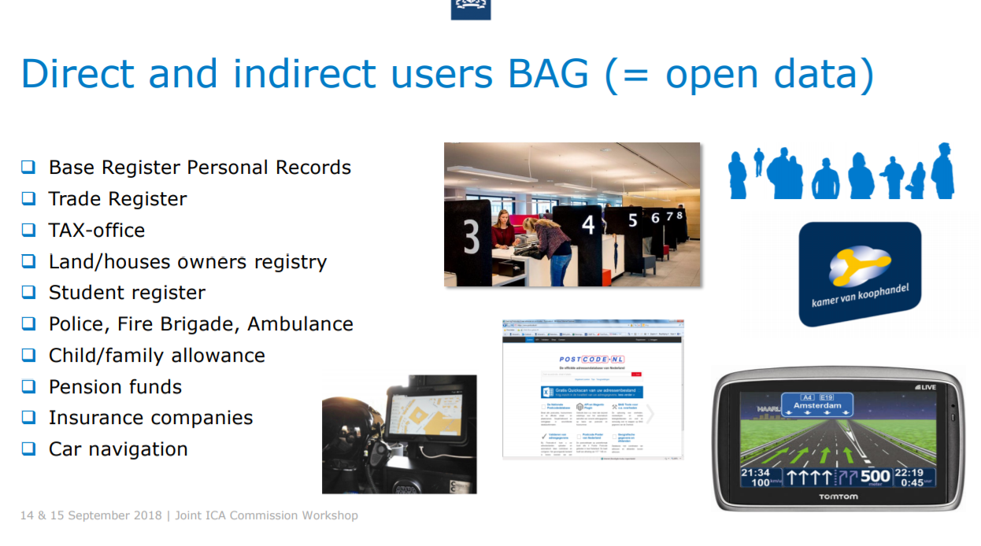
Use case: Base Register Addresses and Buildings in the Netherlands (Martijn Odijk, 2018)
https://sdistandards.icaci.org/wp-content/uploads/2018/10/5_Odijk_BAG-Netherlands_excl_movie.pdf

Slide 75
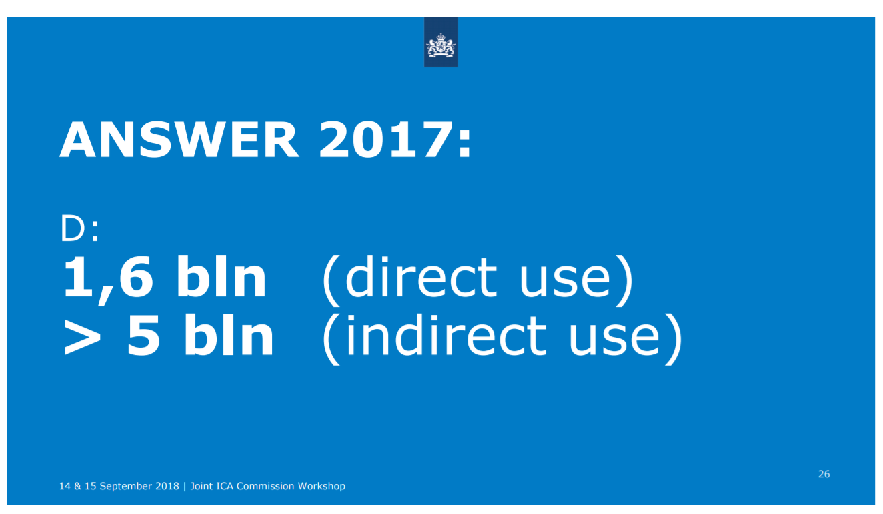

Slide 76
Case study: Open Address Data Denmark
http://odimpact.org/files/case-study-denmark.pdf

Slide 77
Summary

Slide 78
OGC standards are…
well-developed, proven, flexible
Needs some learning efforts
The most common ones:
  WMS (not showed today). Deliver map images
  WFS: deliver data

Slide 79
Standards and Web Services
efficient,
advocates for collaboration and
Supports economic development
attainable and affordable in terms of
  finance,
  human resource,
  IT infrastructure, etc.,
especially if using Open Source

Slide 80
“We all learn
by sharing what we know.“
Robert A. DiBlasi
https://lists.w3.org/Archives/Public/www-svg/2001Dec/0039.html

Slide 81
Recommendations
Collaboration!
Implement a promising first gespatial web service solution
Develop capacities in South Africa:
  By academic education – "Youth development"
  Setup local, young cohorts of gifted people to implement Open Source based web services
Decisions!

Slide 82

“Ubuntu [...] speaks of the very essence of being human. [...] you are generous, you are hospitable, you are friendly and caring and compassionate. You share what you have.
[...] A person with ubuntu is open and available to others, affirming of others, does not feel threatened that others are able and good, for he or she has a proper self-assurance that comes from knowing that he or she belongs in a greater whole and is diminished when others are humiliated or diminished, when others are tortured or oppressed, or treated as if they were less than who they are.”
Desmond Tutu (1999): No Future Without Forgiveness. Doubleday, New York City
© Raimond Spekking / CC BY-SA 4.0 (via Wikimedia Commons)
https://commons.wikimedia.org/wiki/File:Desmond_Tutu_-_Kirchentag_Cologne_2007_(7137).jpg?uselang=de

